Slide 1
Interactive data analysis and visualisation: an introduction to R Shiny apps
PART 3 – APP DESIGN

Slide 2
Why is Design important?
What does design mean when you are thinking about creating an app?
What elements do you need to include in the design of an app?

Slide 3
Users
Style
Data
Language
Layout
Inputs
Accessibility
Outputs
Device

Slide 4
Design
Focus on the user’s goals for needing the app
Make the app easy and intuitive to use
Reduce the need to rewrite code due to making changes

Slide 5
Requirements
It is rare that you will work on an app entirely by yourself
Although you may do all the coding for a project you will often have a “client” (collaborator, supervisor etc) who will also have ideas for what the final app should look like
Discussing the essential requirements for an app before you start designing it means you are all ‘on the same page’

Slide 6
Design elements
User interface – sketch out the layout of your app. Where will the input widgets and the outputs go? Can everything fit on the screen at once? If not – how will you separate the app into different sections.
Data – what data will be required or created by the app?
Inputs – design your input widgets carefully so they meet your requirements
Reactivity – think about the sequence of reactivity in the app (you might also want to sketch this out)
Feedback

Slide 7
Penguins dataset
Available and information at https://allisonhorst.github.io/palmerpenguins/
Install package using install.packages("palmerpenguins")
Load library(palmerpenguins)
Dataset is called penguins

Slide 8
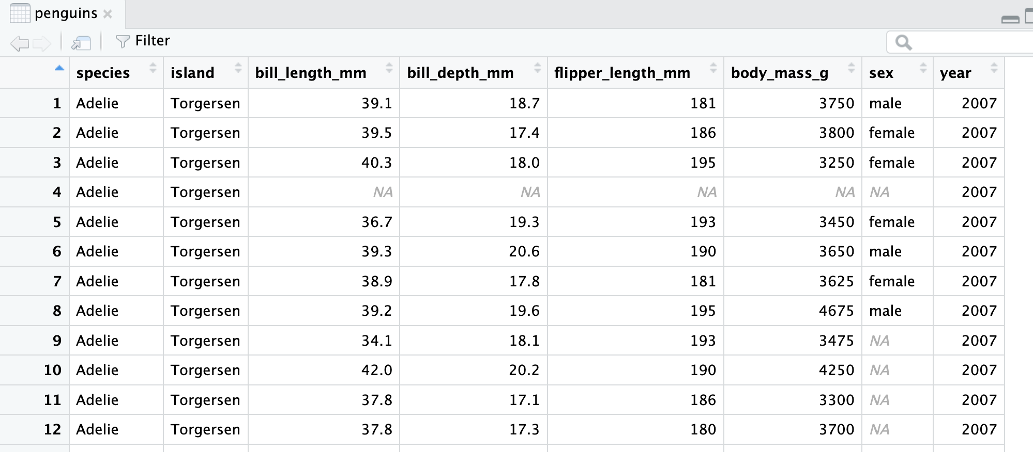
Species: Adelie, Chinstrap, Gentoo
Island: Biscoe, Dream, Torgersen

Slide 9
Create a shiny app
https://github.com/nabury/shiny-masterclass

Slide 10
resources
Files from today - https://github.com/nabury/shiny-masterclass
Shiny tutorial - https://shiny.posit.co/r/getstarted/shiny-basics/lesson1/index.html
Mastering Shiny, Hadley Wickham - https://mastering-shiny.org
Shinyapps - https://www.shinyapps.io
Penguins dataset - https://github.com/allisonhorst/palmerpenguins

